Slide 1


Department of Information Technology
V R Siddhartha Engineering College
GEE-Powered Web Application for Water Quality Monitoring with Remote Sensing
Domain: Satellite Monitoring & Water Resource Management
B.Tech in Information Technology
EPICS Project Review Presentation
Presented by
Harika Anumalashetty (238W1A12D2)
Grandhisila Trinadh (238W1A12E3)
Guduri Sujith Pranay (238W1A12E4)
Under the guidance of
Dr. Jayalaksmhi
Senoir Assistant Professor

Slide 2
AGENDA
Motivation and Problem statement
Objectives and outcomes of the project
Datasets and Requirement specifications
Architecture Diagram
Plan of Implementation
References

Slide 3
MOTIVATION
Water is essential for drinking, farming, industries, and ecosystems. But today, many water bodies becoming polluted due to sewage, chemicals & urban waste.
Testing water quality through fieldwork and lab methods takes a lot of time, manpower, and money. These methods also cover only small areas at a time.
Satellites can capture images of water bodies frequently, covering large areas in a single shot. This helps us see changes in water quality over time.
GEE provides free access to satellite data and has strong tools for processing it online it makes water monitoring and easier compared to normal software

Slide 4
PROBLEM STATEMENT
Regular monitoring of water bodies faces challenges due to high costs, limited coverage, and time-consuming field methods. Satellite-based approaches provide wider coverage but require efficient tools for analysis and interpretation.

Slide 5
OBJECTIVES & OUTCOMES
OBJECTIVES:
Use satellite images to find water quality details like clarity, turbidity, and chlorophyll.
Study changes in water bodies over time and across different seasons.
Create a report to show maps and graphs so anyone can easily understand the water condition.
OUTCOMES:
Satellite-based maps showing the quality of water in different areas.
A Report through which clients can easily view and understand water quality results.
Trends and patterns of water changes over time and seasons.

Slide 6
DATASETS & REQUIREMENT SPECIFICATION
DATASET:
Sentinel-2 MSI (10m resolution)
Landsat-8/9 OLI (30m resolution)
MODIS (temporal trend analysis)
REQUIREMENT SPECIFICATION:
Internet browser (Chrome/Edge/Firefox)
Google Earth Engine account, GEE Code Editor
MS Word/Google Docs
GIS Tools,LaTex

Slide 7
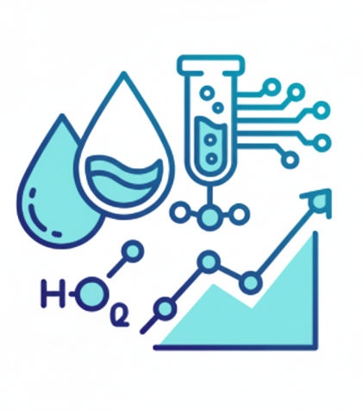



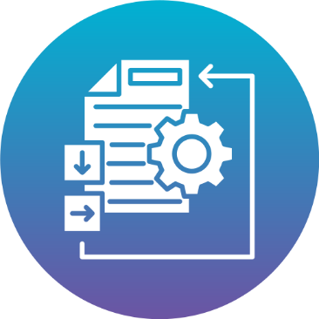

ARCHITECTURE DIAGRAM
DATA COLLECTION

Slide 8
PLAN OF IMPLEMENTATION / METHODOLOGY
DEFINE STUDY AREA
COLLECT SATELLITE DATA
PRE-PROCESS IMAGES
COMPUTE WATER INDICES
MACHINE LEARNING ALGORITHMS
WATER QUALITY ASSESSMENT
GENERATE REPORTS

Slide 9
Google Earth Engine (GEE) Documentation – https://developers.google.com/earth-engine
Official guide for coding, datasets, and geospatial analysis.
2. McFeeters, S. K. (1996). The use of the Normalized Difference Water Index (NDWI) in the delineation of open water features. International Journal of Remote Sensing, 17(7), 1425–1432. Foundational study introducing NDWI for water detection.
3. Rokni, K., Ahmad, A., Selamat, A., & Hazini, S. (2014). Water quality monitoring using remote sensing techniques. Sensors, 14(8), 14845–14875. Comprehensive review on remote sensing water studies.
REFERENCES

